Slide 1
Cloud NAT
Cloud NAT provides network address translation (NAT) for outbound traffic to the internet, Virtual Private Cloud (VPC) networks, on-premises networks, and other cloud provider networks.
Cloud NAT provides NAT for the following Google Cloud resources:
Compute Engine virtual machine (VM) instances
Google Kubernetes Engine (GKE) clusters
Cloud Run instances through Serverless VPC Access or Direct VPC egress
Cloud Run functions instances through Serverless VPC Access
App Engine standard environment instances through Serverless VPC Access
Regional internet network endpoint groups (NEGs)
Using a NAT gateway, you can enable the following types of NAT:
Public NAT
Private NAT

Slide 2
Private NAT
Private NAT allows outbound connections and the inbound responses to those connections. Each Cloud NAT gateway for Private NAT performs source NAT on egress, and destination NAT for established response packets.
Private NAT does not support auto mode VPC networks.
Private NAT doesn't permit unsolicited inbound requests from connected networks, even if firewall rules would otherwise permit those requests.
Each Cloud NAT gateway for Private NAT is associated with a single VPC network, region, and Cloud Router.
You cannot use Private NAT to translate a specific primary or secondary IP address range for a given subnet. A Private NAT gateway performs NAT on all IPv4 address ranges for a given subnet or list of subnets.
Private NAT supports only TCP and UDP connections.
A virtual machine (VM) instance in a VPC network can only access destinations in a non-overlapping—not in an overlapping—subnetwork in a connected network.

Slide 3
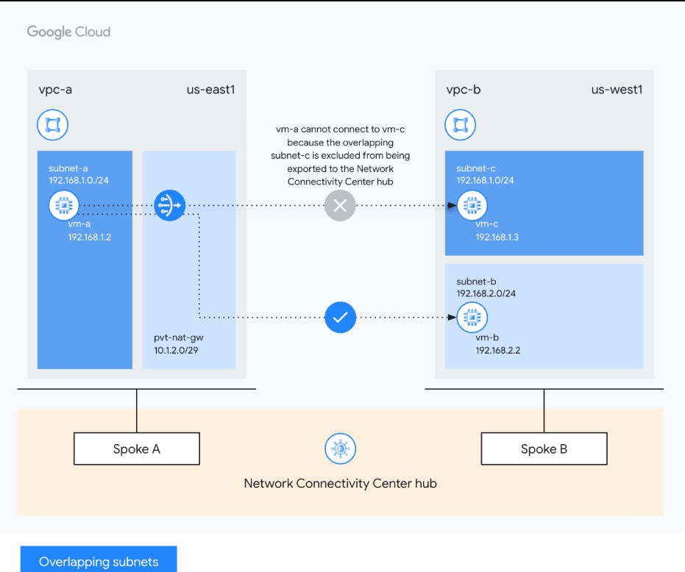
Private NAT for Network Connectivity Center spokes

